Slide 1
The Business Portfolio Matrix
The Boston Consulting group’s business portfolio matrix (BCG matrix) is designed to help with long-term strategic planning, to help a business consider growth opportunities by reviewing its portfolio of products to decide where to invest, to discontinue or develop products. It's also known as the Growth/Share Matrix.

Slide 2
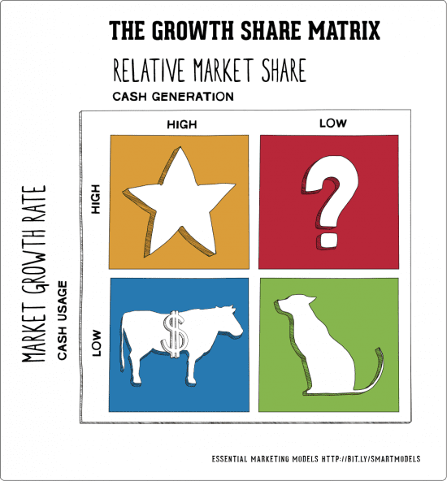

Slide 3
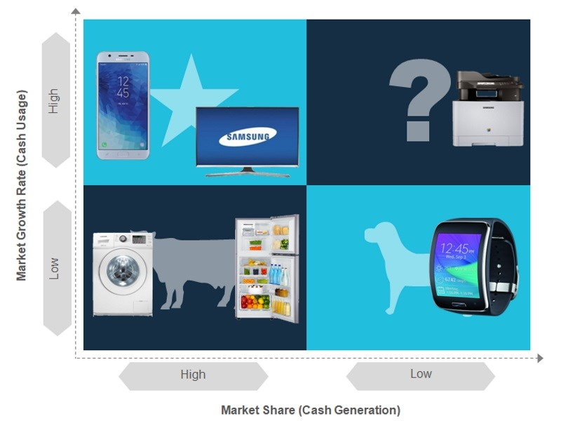

Slide 4
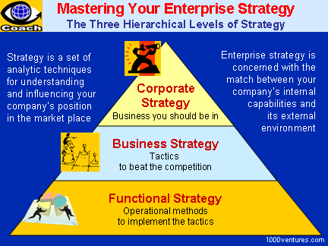
HIERARCHY OF COMPANY STRATEGIES

Slide 5
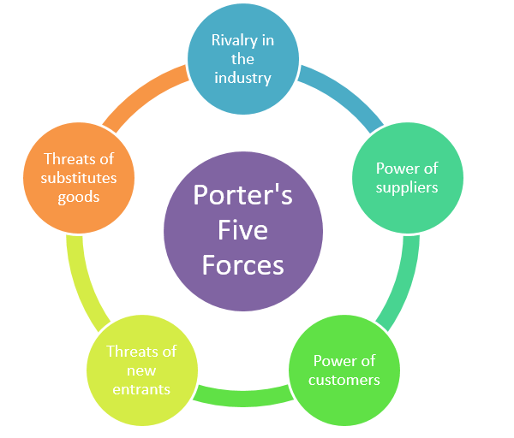
Porter’s Industry Analysis

Slide 6
Professor Michael Porter suggests that strategy formulation requires an analysis of the attractiveness of an industry and the company’s position within that industry. This analysis becomes the basis for formulating generic strategies.

Slide 7
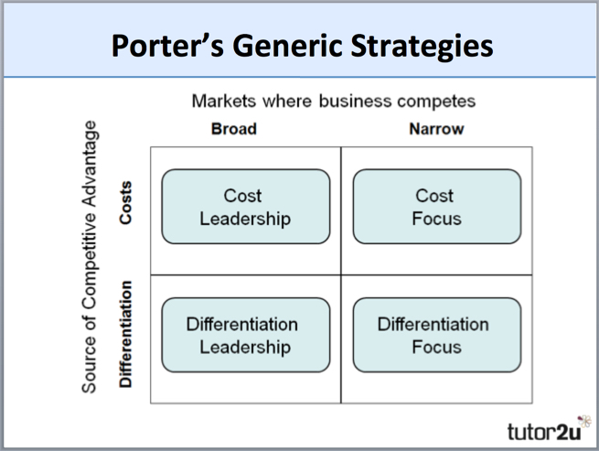
Porter’s Generic Competitive Strategies

Slide 8
Planning Premises
Planning premises: The anticipated environment in which plans are expected to operate.
The process of planning is based upon estimates and predictions of the future. Though past guides the plans in present, plans achieve the goals in the future. Therefore, the forecast of future events leads to efficient plans. Since future events are not known accurately, the assumption is made about these events.

Slide 9
By identifying the factors (assumptions) that affect plans is called premising and the methods used for making premises are called forecasting.

Slide 10
Types of Planning premises
Internal and External Premises
Internal Premises come from the business itself. It includes the skills of the labor force, investment policies of the company, management style, sales forecasts, etc.
External Premises come from the external environment. That is economic, technological, social, political and even cultural environment. External premises cannot be controlled by the business.

Slide 11
Controllable, Semi-controllable and Uncontrollable Premises
Controllable Premises are fully controlled by the management. They include factors like materials, machines, and money.
Semi-controllable Premises are partly controllable. They include marketing strategy.
Uncontrollable Premises as the name suggests are those over which the management has absolutely no control. Take for example weather conditions, consumer behavior, natural disasters, wars, etc

Slide 12
Environmental forecasting
Estimating the intensity, nature, and timing of the external forces that may effect the performance of a firm, disrupt its plans, or force a change in its strategies.

Slide 13
Areas of forecasting
The environmental areas that are frequently chosen for making forecasts include the:
Economic
Social
Political/legal
Technological environments

Slide 14
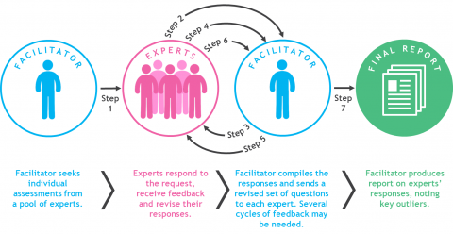
Forecasting with the Delphi technique

